Slide 1
Web Engineering: Lab - 01
To understand HTML basics for developing web applications

Slide 2

Internet
Global network (network of networks) connecting millions of computers, using a standard communication mechanism (TCP/IP protocol) to carry out the information exchange and other activities.
It provides the infrastructure Via which we exchange information.

Slide 3


Internet Vs Web
The Internet is a massive network of networks, a networking infrastructure.
These machines are connected together to share information but there are several ways to do it, including among others:
E-mail
Instant messaging
File transfer using FTP

Slide 4
Internet Vs Web (Cont’d)
The global network or World Wide Web (WWW) is one of many ways of exchanging information via the Internet.
The Web is a collection of documents that are interconnected by links in web pages. These documents are accessed by web browsers and provided by web servers.

Slide 5

Web Browsers
Browser is a software product that allows you to search and display Web pages
Much of its work consists is two tasks
First, ask for Web pages
What happens when you type the address of a site (such as www.google.com) or clicks on a link on a page??

Slide 6
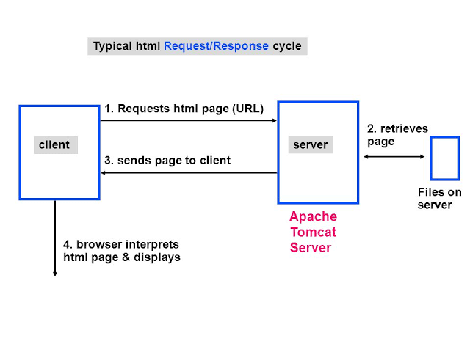
Web Browsers
The browser sends that request to a remote computer called server, usually more powerful than a home computer system because it needs to handle multiple requests simultaneously.
The Web server responds with the contents of the desired Web page.

Slide 7
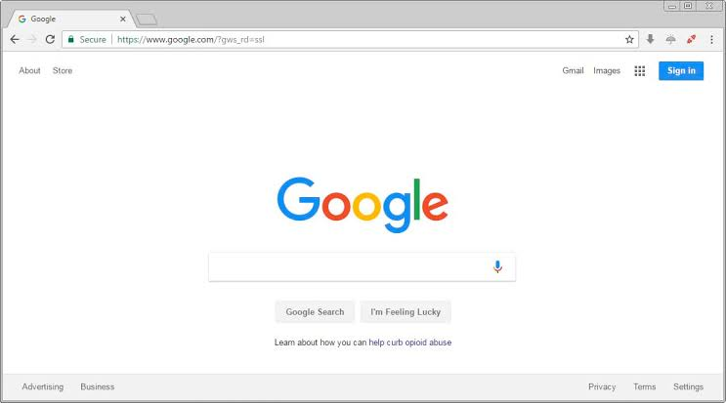
Web Browsers
When a browser obtains such content it uses its second ability and displays or draws the Web page.

Slide 8

Web Engineering
Web Engineering is the application of systematic, disciplined and quantifiable approaches to development, operation, and maintenance of Web- based applications.

Slide 9
Web Development
Web development tends to break down into three main concentrations: front-end, back-end, and full stack.
Front-End Developer
Front End developer deals with the front end. The front end of a website is the part that users interact with. Everything that you see when you’re navigating around the Internet, from fonts and colors to dropdown menus and sliders, being controlled by your computer’s browser.

Slide 10
Web Development
Back-End Developer
So what makes the front end of a website possible? Where is all that data stored? This is where the back end comes in. The back end of a website consists of a server, an application, and a database. A back-end developer builds and maintains the technology that powers those components which, together, enable the user-facing side of the website to even exist in the first place.

Slide 11
HTML(Hypertext markup language)
HTML is not a programming language.
It is a markup language.
Defines the structure of your content.
Markup language, a standardized set of notations used to annotate a plain-text document's content to give information regarding the structure of the text or instructions for how it is to be displayed
Hypertext is text which is not constrained to be linear. Hypertext is text which contains links to other texts.

Slide 12
HTML(Hypertext markup language)
Case insensitive language
Html is translated by means of a web browser on the client side
Client side scripting language

Slide 13
Basic Terminology
HTML ELEMENTS/ TAGS/ MARKUPS: Html elements or tags provide instructions for how information will be processed or displayed. Enclosed in <>
DELIMITERS ( <, >, /): Delimiters surround the tag and inform the parser that it should read the enclosed information as an HTML element.
ATTRIBUTE: Attributes contain extra information about the element that you don't want to appear in the actual content. The value for the attribute is enclosed in quotation marks.

Slide 14
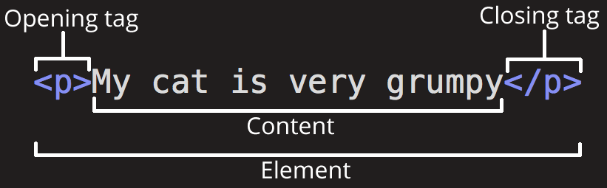
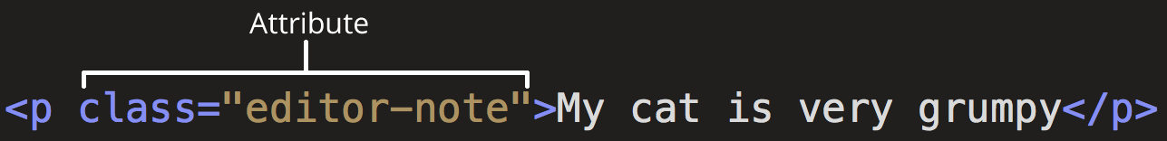
Anatomy of an HTML element
My cat is very grumpy

Slide 15
Anatomy of an HTML document
<!DOCTYPE html>
<html>
<head>
<title></title>
</head>
<body>
</body>
</html>
The <!DOCTYPE html> declaration defines this document to be HTML5
<html>..</html>: These tags enclose the entire HTML document & tell the browser that it is reading an HTML document
<head>..</head>: The HEAD element contains information about the document.
<body>..</body>: It encloses the body (text, images, tags, links) of the HTML document. The BODY element contains the information in the document.
The <title> element specifies a title for the document

Slide 16
Simple HTML program
<!DOCTYPE html>
<html>
<head>
<title>Hello, world</title>
</head>
<body>
Hello, world
</body>
</html>

Slide 17
Tag Types
Paired tags: They require a starting and an ending tag e.g: <html></html>
Unpaired/Singular/Empty tags: They require only a starting tag e.g.: <br/> <input/> or simply <br> <input>

Slide 18
Marking up text
This section will cover some of the essential HTML elements you'll use for marking up the text.

Slide 19
Some Important tags
HTML Headings
Heading elements allow you to specify that certain parts of your content are headings — or subheadings.
In the same way that a book has the main title, chapter titles and subtitles, an HTML document can too.
HTML contains 6 heading levels
<h1>My main title</h1>
<h2>My top level heading</h2>
<h3>My subheading</h3>
<h4>My sub-subheading</h4>

Slide 20
Some Important tags
Paragraphs: As explained above, <p> elements are for containing paragraphs of text; you'll use these frequently when marking up regular text content
<q>: All the text within this tag is enclosed in quotation marks in the output.
<br>: break inserts new line
<center>..</center>: centers your text

Slide 21
Images
<img src="images/firefox-icon.png" alt="My test image“height=“50” width=“50”>
TITLE: It specifies a tool tip text for the image. (Some browsers support the alt attribute for display tooltip while others support title).
ALT: You specify descriptive text for users who cannot see the image. Either They are visually impaired. Something has gone wrong causing the image not to display.
SRC: The URL or the path of the image.
HEIGHT & WIDTH: It specifies the height and width for the image.

Slide 22
Some Important tags
Links
ANCHOR TAG <a>..</a>: A web link can be created in html using the anchor tag.
ATTRIBUTES:
TITLE: It specifies a tooltip text for the anchor tag.
HREF: The HREF attribute creates a link to another document or anchor and leads the user to the address indicated in its URL.
e.g: <a href=“http://google.com”>Google it</a>

Slide 23
Other Attributes Of <a> Tag
MAIL TO ATTRIBUTE: The MAILTO attribute is used to insert an e-mail link into the document. MAILTO is useful as it enables us to create a link on your home page so that readers can send you comments.
EXAMPLE:
<a HREF= “MAILTO:webteam@literacy.kent.edu”> webteam@literacy.kent.edu </a>
Send mail to webteam@literacy.kent.edu

Slide 24
Other Attributes Of <a> Tag
DOWNLOAD: The anchor tag can also be used to create a download link as:
<a href= “Sample2.html” download=”file.txt”> Download </a> the above statement downloads the file at the url with the name file.txt onto our computer when Download link is clicked.

Slide 25
Bookmarking using<a> TAG
Bookmarks in a webpage allow a reader to jump to any specific part of the webpage.
Bookmarks can be useful if your webpage is very long.
To make a bookmark, you must first create the bookmark, and then add a link to it. When the link is clicked, the page will scroll to the location with the bookmark.

Slide 26
Bookmarking using<a> TAG
First create a bookmark with the id attribute:
<h3 id="C4">Chapter 4</h2>
Then, add a link to the bookmark ("Jump to Chapter 4"), from within the same page using # to jump to that bookmark from the link:
<a href="#C4">Jump to Chapter 4</a>

Slide 27
Absolute versus relative URLs
Absolute URL: Points to a location defined by its absolute location on the web, including protocol and domain name
E.g: http://www.example.com/projects/index.html
Relative URL: Points to a location that is relative to the file you are linking from, more like what we looked at in the previous section.
E.g: projects/index.html

Slide 28
Whitespace in HTML
No matter how much whitespace you use (which can include space characters, but also line breaks), the HTML parser reduces each one down to a single space when rendering the code.
Increases readability of code (nice formatting)

Slide 29
Entity references: Including special characters in HTML
In HTML, the characters <, > are special characters.
They are parts of the HTML syntax itself, so how do you include one of these characters in your text.
We have to use character references — special codes that represent characters, and can be used in these exact circumstances.

Slide 30
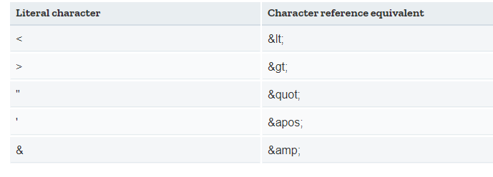
Entity references: Including special characters in HTML

Slide 31
Entity references: Including special characters in HTML
Example:
Without entity references
<p>In HTML, you define a paragraph using the <p> element.</p>
With entity references
<p>In HTML, you define a paragraph using the &lt;p&gt; element.</p>

Slide 32
HTML comments
To turn a section of content inside your HTML file into a comment, you need to wrap it in the special markers <!-- and -->
Example
<p>I'm not inside a comment</p>
<!-- <p>I am!</p> -->

Slide 33
Block versus inline elements
Block-level elements form a visible block on a page — they will appear on a new line from whatever content went before it, and any content that goes after it will also appear on a new line. E.g: paragraphs, lists, navigation menus, footers
An inline element will not cause a new line to appear in the document; they would normally appear inside a paragraph of text e.g: <a>, <strong> etc
A block-level element wouldn't be nested inside an inline element, but it might be nested inside another block-level element.

Slide 34
Lists
Unordered: Unordered lists are used to mark up lists of items for which the order of the items doesn't matter — let's take a shopping list e.g eggs, bread, butter etc
Every unordered list starts off with a <ul> element — this wraps around all the list items and the last step is to wrap each list item in a <li> (list item) element:
<ul>
<li>milk</li>
<li>eggs</li>
</ul>

Slide 35
Lists
Ordered: Ordered lists are lists in which the order of the items does matter — let's take a set of directions
The markup structure is the same as for unordered lists, except that you have to wrap the list items in an <ol>
<ol>
<li>Drive to the end of the road</li>
<li>Turn right</li>
<li>Go straight across the first two roundabouts</li>
</ol>

Slide 36
Lists
HTML Description Lists A description list is a list of terms, with a description of each term.
The <dl> tag defines the description list, the <dt> tag defines the term (name), and the <dd> tag describes each term:
<dl>
<dt>Coffee</dt>
<dd>- black hot drink</dd>
<dt>Milk</dt>
<dd>- white cold drink</dd>
</dl>

Slide 37
Tables
An HTML table is defined with the <table> tag.
Each table row is defined with the <tr> tag.
A table header is defined with the <th> tag. By default, table headings are bold and centered.
A table data/cell is defined with the <td> tag.

Slide 38
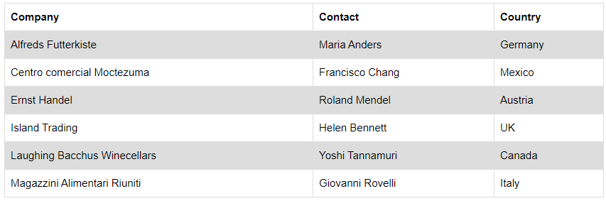
Tables

Slide 39
Tables
<table > <tr> <th>Firstname</th> <th>Lastname</th> <th>Age</th> </tr> <tr> <td>Jill</td> <td>Smith</td> <td>50</td> </tr> <tr> <td>Eve</td> <td>Jackson</td> <td>94</td> </tr> </table>

Slide 40
Tables Attributes
To make a cell span more than one column, use the colspan attribute: e.g <th colspan="2">Telephone</th>
To make a cell span more than one row, use the rowspan attribute: e.g <th rowspan="2">Telephone:</th>
To add a caption to a table, use the <caption> tag:
<table>
<caption>Monthly savings</caption>….
<\table>

Slide 41
Tables
<thead>,<tbody> and <tfoot> tags:
The <thead>, <tbody> and <tfoot> elements are used together to specify each part of a table (header, body, footer).

Slide 42
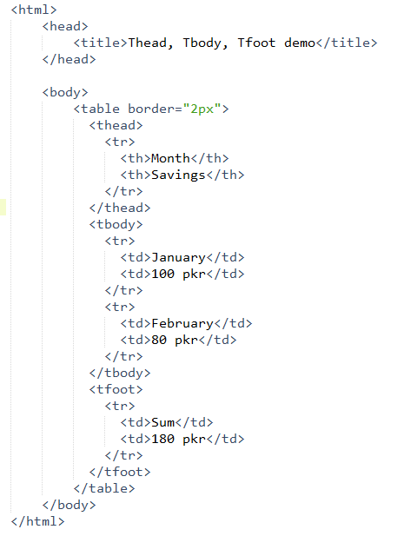
Tables

Slide 43
Formatting Tags
<Address>: This tag is used to display the address of some organization or person. It is basically used as “footer”. All the text within this tag is automatically displayed within italic.
<BLOCKQUOTE>...</BLOCKQUOTE>: It is used for long quotes or citations which are automatically indented

Slide 44
Formatting Tags
Tag | Description
<b>, <i> | Bold text, italic text
<u>,<ins> | Both the tags display underlined text
<strong> | Important text
<em> | Emphasized text
<mark> | Marked text (highlighted)
<small> ,<big> | Small and big text
<del> | Deleted text (striked from middle)
<sub>, <sup> | Subscript text and superscript text

Slide 45
Lab Task: Marking up a letter
1. Create a simple webpage displaying your entire bio data including an image and an anchor tag for your email.
2. The sample image on next slide shows an example of what the letter might look like after being marked up.
Create a simple webpage displaying this output (note: you can make variations like use your own content or give it a much better structure)

Slide 46
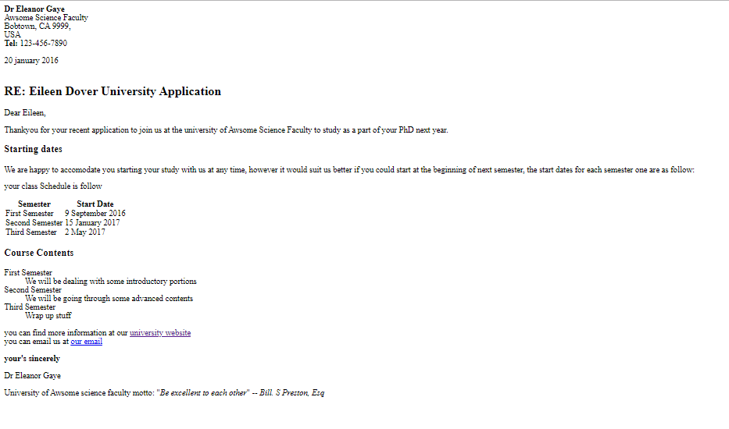
Lab Task: Marking up a letter

